Slide 2
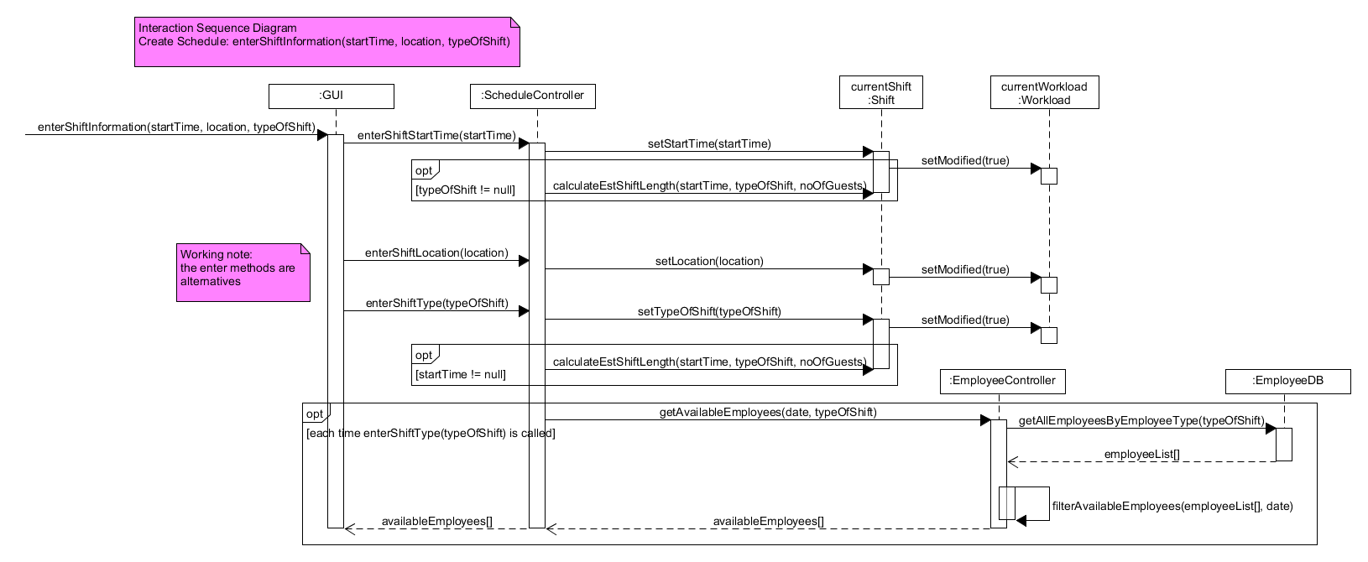
ISD enterShiftInformation

